Slide 1
CS 2212
Introduction to Software Engineering
Chapter 25 Creating a Viable Software Plan

Slide 2
Copyright Notice This Presentation and Its Associated Video Contain Copyright Material. This Presentation and Its Associated Video Are Provided for Teaching Purposes of CS2212 and Should Not Be Posted In Any External Site, Or Shared with. This Presentation and Its Associated Video Are Provided For Instructional Personal Use Only, and Only For The Purposes of the CS2212 Course.

Slide 3
Part 49
Cost Estimation Concepts
An evolving system increases its complexity unless work is done to reduce it.
― Meir Lehman.
Notes:
This lesson introduces the basic steps in a software engineering project at a high level.
In practice, steps often overlap.

Slide 4
Learning Objectives in this Part
To understand the concept and the parameters that influence cost in software development estimation

Slide 5
Process/Project Management
Project management involves a whole host of issues and skills
Effort estimation
Staffing
Defining and managing the process
Scheduling activities
Monitoring quality
…
Process management at the level of an organization
A software development organization should define, implement and constantly improve their
Software processes
Organizational structure

Slide 6
The four variables
The main four variables of a project
Development cost
Time
Quality
Scope
Development cost, time and quality are bad control variables
The number of developers can only be incrementally increased (negative effects beyond the optimal count)
Deadlines are often predetermined externally (e.g., market window, important presentation)
Low quality upsets customers and developers
Scope is the only real control variable

Slide 7
The “Vicious Square”
Quality
Scope
+
+
Productivity
-
-
+
+
-
-
Development time
Cost

Slide 8
Accuracy of Estimation
x – the actual cost of the system
4x
Estimates on projects studied by Barry
Boehm occupied the area between the curves
2x
Feasibility
Requirements
Design
Code
Delivery
x
0.5x
As a project progresses, more information about
the progress becomes available and the accuracy
of estimation can be increased over time.
0.25x

Slide 9
Estimation techniques
Expert judgement
Estimation by analogy
Parkinson's Law
Pricing to win
Top-down estimation
Bottom-up estimation
Function point estimation
Algorithmic cost modelling
©Ian Sommerville

Slide 10
Part 50
The Function Point Metric
One accurate measurement is worth a thousand expert opinions.
― Grace Hopper.
Notes:
This lesson introduces the basic steps in a software engineering project at a high level.
In practice, steps often overlap.

Slide 11
Learning Objectives in this Part
To learn about the Function Point Metric

Slide 12
Function Points
The idea of function point was first proposed by Albrecht in 1979.
The function point of a system is a measure of the “functionality” of the system.
Steps
Counting the information domain – counting FPs
Assessing complexity of the software – adjusting FPs
Applying an empirical relationship to come up with LOC or P-months based on the adjusted FPs
This method cannot be performed automatically
©Ian Sommerville

Slide 13
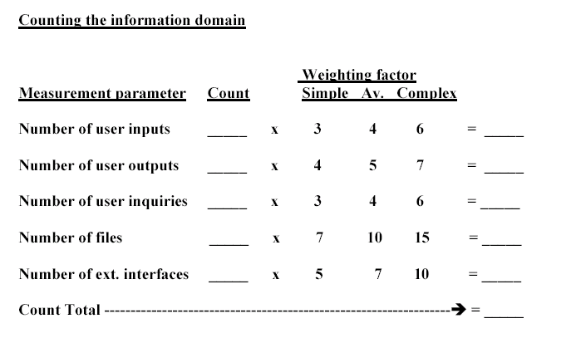
Counting Function Points

Slide 14
Counting Function Points
User inputs. Each user input that provides distinct application oriented data to the software is counted.
User outputs. Each user output that provides application oriented information to the user is counted. Individual data items within a report are not counted separately.
User inquiries. This is an on-line input that results in the generation of some response.
Files. Each master file is counted.
External interfaces. Each interface that is used to transmit information to another system is counted.

Slide 15
Adjusting Function Points
Answer the following questions using a scale of [0-5]: 0 not important; 5 absolutely essential. We call them influence factors (F_{i}).
1. Does the system require reliable backup and recovery?
2. Are data communications required?
3. Are there distributed processing functions?
4. Is performance critical?
5. Will the system run in an existing, heavily utilized operational env.?
6. Does the system require on-line data entry?

Slide 16
Adjusting Function Points
7. Does the on-line data entry require the input transaction to be built over multiple screens or operations (user efficiency)?
8. Are the master files updated on-line?
9. Are the inputs, outputs, files, or inquiries complex?
10. Is the internal processing complex?
11. Is the code designed to be reusable?
12. Is installation included in the design?
13. Is the system designed for multiple installations?
14. Is the application designed to facilitate change and ease of use by the user?

Slide 17
Map FPs to LOC
Use an empirical relationship
Function point = count total × [0.65 + 0.01 × (sum of the 14 F_{i})]
Companies may want to refine their own version
According to a 1989 study, implementing a function point in a given programming language requires the following number of lines of code
Assembly 320
C 128
COBOL 106
C++ 64
Visual Basic 32
SQL 12
See www.ifpug.org for more information on FP

Slide 18
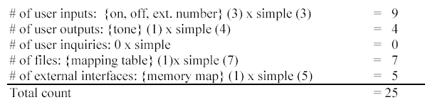
Example: Project X

Slide 19
Example: Project X
Total of FPs = 25
F₄ = 4, F₁₀ = 4, other F_{i}’s are set to 0. Sum of all F_{i}’s = 8.
FP = 25 x (0.65 + 0.01 x 8) = 18.25
Lines of code in C = 18.25 x 128 LOC = 2336 LOC
In the past, students have implemented their projects using about 2500 LOC.

Slide 20
Part 51
Algorithmic Cost Estimation: The COCOMO Model
Engineering is done with numbers. Analysis without numbers is only an opinion.
― 1st of Akin's Laws of Spacecraft Design.
Notes:
This lesson introduces the basic steps in a software engineering project at a high level.
In practice, steps often overlap.

Slide 21
Learning Objectives in this Part
To learn how to estimate software development effort and cost using the COCOMO model

Slide 22
Algorithmic cost modelling
Cost is estimated as a mathematical function of product, project and process attributes whose values are estimated by project managers and metrics (e.g. KPIs) collected by DevOps tools.
The most commonly used product attribute for cost estimation is LOC (code size)
Most models are basically similar but are utilizing different attributes

Slide 23
The COCOMO model
Developed at TRW, a US defence contractor
Based on a cost database of more than 60 different projects
COCOMO is provided in three different versions:
Basic - computes a 'ball-park’ effort estimate based on product attributes
Intermediate – Enhances the estimate provided by the Basic COCOMO version using also project and process attributes
Advanced – Computes estimates for differ project phases and parts separately

Slide 24
Project Types
Organic mode projects : Small teams, familiar environment, well-understood applications, no difficult non-functional requirements (EASY)
Semi-detached mode projects: Project team may have experience mixture, system may have more significant non-functional constraints, organization may have less familiarity with application (HARDER)
Embedded projects: Hardware/software systems, tight constraints, unusual for team to have deep application experience (HARD)

Slide 25
Basic COCOMO Formula
Organic mode projects: PM = 2.4 (KDSI) ^{1.05}
Semi-detached mode projects: PM = 3 (KDSI) ^{1.12}
Embedded mode projects: PM = 3.6 (KDSI) ^{1.2}
KDSI = Kilo Delivered Source Instructions

Slide 26
Development Time Estimates
Organic: TDEV = 2.5 (PM) ^{0.38}
Semi-detached: TDEV = 2.5 (PM) ^{0.35}
Embedded mode: TDEV = 2.5 (PM) ^{0.32}
Personnel requirement: N = PM/TDEV
This last formula needs to be adjusted (see next slide)
Adapted from Ian Sommerville

Slide 27
Basic COCOMO Assumptions
Implicit productivity estimate
Organic mode = 16 LOC/day (averaged across the life cycle of similar projects)
Embedded mode = 4 LOC/day (averaged across the life cycle of similar projects)
Time required is a function of total effort NOT team size

Slide 28
Basic COCOMO Example
Organic mode project, 32KLOC
PM = 2.4 (32) ^{1.05} = 91 person months
TDEV = 2.5 (91) ^{0.38} = 14 months
N = 91/15 = 6.5 people
Embedded mode project, 128KLOC
PM = 3.6 (128)^{1.2} = 1216 person-months
TDEV = 2.5 (1216)^{0.32} = 24 months
N = 1216/24 = 51

Slide 29
Intermediate COCOMO
The Intermediate version of COCOMO takes the estimates provided by the Basic COCOMO version as starting point for its computation
Takes into account different additional attributes which affect cost. Each attribute has a score and weight.
Personnel related attributes
Product related attributes
Computer / infrastructure related attributes
Project related attributes
Multiplies basic cost by attribute multipliers which may increase or decrease costs

Slide 30
Personnel and Product Attributes
Personnel attributes
Analyst capability
Virtual machine experience
Programmer capability
Programming language experience
Application experience
Product attributes
Reliability requirement
Database size
Product complexity

Slide 31
Computer and Project Attributes
Computer attributes
Execution time constraints
Storage constraints
Virtual machine volatility
Computer turnaround time
Project attributes
Modern programming practices
Software tools
Required development schedule

Slide 32
Attribute Choice
These are attributes which were found to be significant in most project studies
Other attributes may be more significant for other projects and is up to the organization which develops the system to assess the choice of attributes
In practice, each organization must identify its own attributes and associated multiplier values. This may come by examining past similar projects and calculating the associated multiplier values (e.g. through regression on data form past cases).

Slide 33
Intermediate COCOMO Example
Embedded software system on microcomputer hardware.
Let us assume that basic COCOMO predicts a 45 person-month effort requirement.
Let us assume that we have applied the attributes = RELY (1.15), STOR (1.21), TIME (1.10), TOOL (1.10)
Then, the Intermediate COCOMO predicts:
45*1.15*1.21.1.10*1.10 = 76 person-months.
Total cost = 76*$7000 = $532, 000
Adapted from Ian Sommerville

Slide 34
Estimation methods - Summary
Function points
SRS -> LOC
SRS -> PM
COCOMO
LOC -> PM
May use FP as a front-end to COCOMO
COCOMO II
Refined version with different estimation models based on
Requirements (FP->PM),
Early design (FP->PM), and
Architecture (FP or LOC->PM)

Slide 35
Estimation methods - Summary
Each method has strengths and weaknesses
Estimation should be based on several methods
If these do not return approximately the same result, there is insufficient information available
Some action should be taken to find out more in order to make more accurate estimates
Pricing to win is often used in situations bidding for a project (e.g. responding to a government Requests for Tenders)

Slide 36
Your Turn
Discuss three limitations of the COCOMO model
Why using Function Points Analysis early in the project life cycle (e.g. during early requirements) is not as accurate an estimate as when performing it later in the life cycle (e.g. after architectural design)
Check-out the content of the following sites:
https://en.wikipedia.org/wiki/Cost_estimation_in_software_engineering
https://www.javatpoint.com/software-cost-estimation
https://www.tutorialspoint.com/estimation_techniques/estimation_techniques_function_points.htm
https://www.javatpoint.com/software-engineering-functional-point-fp-analysis
https://www.geeksforgeeks.org/software-engineering-functional-point-fp-analysis/
https://en.wikipedia.org/wiki/Function_point
https://www.geeksforgeeks.org/software-engineering-cocomo-model/
https://en.wikipedia.org/wiki/COCOMO

